Slide 1
Introduction to Marketing

Slide 2
Preview
Discuss what is marketing and core concepts of marketing and review some possible definitions
See the evolution of marketing thought and discuss various orientations toward marketplace
Focus on modern marketing concept, identify four pillars of modern marketing
Describe 4Ps of marketing, as elements of total marketing mix
Discuss modern marketing concept comparing it with selling concept and extending it with relationship marketing concept

Slide 3
Introduction to Marketing
Marketing;
  “Satisfying customer needs”
  “Meeting needs profitably”
  “Generating customer value at a profit”
    “Managing profitable customer relationships by delivering superior value to customers”

Slide 4
Introduction to Marketing
Marketing;
  “Satisfying customer needs”
  “Meeting needs profitably”
  “Generating customer value at a profit”
    “Managing profitable customer relationships by delivering superior value to customers”

Slide 5
What is Marketing?
No single correct definition or approach
Common subject matters:
  The ability to satisfy customers,
  The identification of favorable marketing opportunities,
  The need to create an edge over competitors,
  The capacity to make profits to enable a viable future for the organization,
  The use of resources to maximize a business’ market position,
  The aim to increase market share mainly in target markets

Slide 6
Marketing Process
Capture value from
customers in return
Create value for customers and build customer relationships
Capture value from customers to create profits and customer quality
Understand the marketplace and customer needs&wants
Design a customer-driven marketing strategy
Construct a marketing program that delivers superior value
Build profitable relationships and create customer delight

Slide 7


Core Concepts of Marketing
Needs, wants,
and demands
Markets
Products
and services
Exchange,
transactions,
and relationships
Value and
satisfaction

Slide 8
Core Concepts of Marketing
Need
  Basic human requirements
  State of felt deprivation
    Example: Need food
Wants
  Needs directed to specific objects
  The form of needs as shaped by culture and the individual
    Example: Want a Big Mac
Demands
  Wants which are backed by buying power
Needs, wants, and demands
Marketing offers: including products, services and experiences
Value and satisfaction
Exchange, transactions and relationships
Markets

Slide 9
Core Concepts of Marketing
Needs, wants, and demands
Marketing offers: including products, services and experiences
Value and satisfaction
Exchange, transactions and relationships
Markets
Marketing offering
  Combination of products, services, information or experiences that satisfy a need or want
  Offer may include services, activities, people, places, information or ideas

Slide 10
Core Concepts of Marketing
Products
Anything that can be Offered to a Market to Satisfy a Need or Want
Experiences
Persons
Places
Organizations
Information
Ideas
Services
Activities or Benefits Offered for Sale That Are Essentially
Intangible and Don’t Result in the Ownership of Anything

Slide 11

Market Offerings - examples
Marketing places : Creating positive attitudes or maintaining attitudes & behavior toward particular places

Slide 12

Market Offerings- examples
Marketing ideas
(social marketing)
This is the watch
Stephen Hollingshead, Jr. was wearing when he encountered a drunk driver.
Time of death 6:55 p.m.
“Friends Don’t Let Friends
Drive Drunk”

Slide 13
Core Concepts of Marketing
Value
  Customers form expectations regarding value
  Marketers must deliver value to consumers
Satisfaction
  A satisfied customer will buy again and tell others about their good experience
Needs, wants, and demands
Marketing offers: including products, services and experiences
Value and satisfaction
Exchange, transactions and relationships
Markets

Slide 14




Core Concepts of Marketing
  Value Gained From Owning a Product and Costs of Obtaining the Product is “Customer Value”
Product’s Perceived Performance in Delivering Value Relative to Buyer’s Expectations is “Customer Satisfaction”
Total Quality Management Involves Improving the Quality of Products, Services, and Marketing Processes

Slide 15
Core Concepts of Marketing
Exchange
  The act of obtaining a desired object from someone by offering something in return
Transaction
  Trade of values between two or more parties
One exchange is not the goal, relationships with several exchanges are the goal
Relationships are built through delivering value and satisfaction
  Marketing network ğ consists of the company and all its supporting stakeholders
Needs, wants, and demands
Marketing offers: including products, services and experiences
Value and satisfaction
Exchange, transactions and relationships
Markets

Slide 16
Core Concepts of Marketing
Needs, wants, and demands
Marketing offers: including products, services and experiences
Value and satisfaction
Exchange, transactions and relationships
Markets
Market
  Set of actual and potential buyers of a product
  Marketers seek buyers that are profitable

Slide 17
Simple Marketing System
Communication
Industry
(a collection
of sellers)
Market
(a collection
of Buyers)
Products/services
Money
Information

Slide 18
Marketing defined as...
Process by which individuals and groups obtain what they need and want through creating and exchanging products and value with others.
  Simply put: Marketing ğ the delivery of customer satisfaction at a profit.

Slide 19
More Definitions of Marketing
A social and managerial process by which individuals and groups obtain what they need and want through creating, offering and exchanging products and services of value with others.
The management process responsible for identifying, anticipating and satisfying customer requirements profitably.
Marketing consists of individual and organizational activities that facilitate and enhance satisfying exchange relationships in a dynamic environment through the creation, servicing, distribution, promotion and pricing of goods, services and ideas

Slide 20
More Definitions of Marketing (cont.)
From the societal perspective; some marketers describe marketing as the creation and delivery of a standart of living.
From the managerial perspective; marketing (management) is the process of planning and executing the conception, pricing, promotion and distribution of goods and services to create exchanges that satisfy individual and organizational goals.

Slide 21
Marketing Management
Marketing management ğ the art and science of choosing target markets and building profitable relationships with them.
  This definition must include answers to 2 questions:
    What customers will we serve?
    How can we serve these customers best?
  Getting, keeping, and growing customers through creating, delivering, and communicating superior customer value
Marketing management involves ğ managing demand ğ involves managing customer relationships

Slide 22
Marketing Management
Marketing management can be defined in broader terms as “demand management”;
  Marketers aim to influence the level, timing and composition of demand to meet organizational goals.
Marketing management is concerned
  not only with finding and increasing demand,
  but also with changing or even reducing it : demarketing!
    Demarketing’s aim is to reduce the number of customers or to shift their demand temporarily or permanently
      (e.g. move traffic away from a popular tourist attraction during peak demand times)

Slide 23
Evolution of Marketing Thought
How marketing has become “marketing” as we understand it and apply its practices today?

Slide 24
Evolution of Marketing Thought
Production Era (1850s-1920s)
  Industrial revolution; mass production
  Few products and little competition
Sales Era (1920s-1950s)
  The focus was on personal selling and advertising
  Sales seen as the major means for increasing profits
Mktg Era (1950s-present)
  Customer orientation replaced the “hard sell” of the sales-led era
  Determination of the needs and wants of customers before introducing products or services

Slide 25
Evolution of Marketing Thought
Relationship Marketing Era: 1990s-
  Marketing era has recently shifted from being “transaction-based” ğ to focusing on “relationships”
  The argument ğ traditional marketing practices focused on attracting new customers rather than retaining existing ones.
  It is equally important to hang on to existing customers so that they become repeat buyers and long term loyal customers
        “customer relationship management”!

Slide 26
Company Orientations Towards the Marketplace
Production Concept
Consumers prefer products that are
widely available and inexpensive
Product Concept
Consumers favor products that
offer the most quality, performance,
or innovative features
Selling Concept
Consumers will buy products only if
the company aggressively
promotes/sells these products
Marketing Concept
Focuses on needs/ wants of target
markets & delivering value
better than competitors

Slide 27
Production Concept
Consumers will favor those products that are widely available and low in cost.
Managers concentrate on achieving high production efficiency and wide distribution.
The assumption is valid at least in 2 situations :
  The demand for a product exceeds supply (suppliers will concentrate on finding ways to increase production)
  The product’s cost is high and has to be decreased to expand the market.

Slide 28
Product Concept
Consumers will favor those products that offer the most quality, performance or innovative features.
Managers in product-oriented organizations concentrate on making superior products and improving them over time.
The assumption ğ the customers will admire well-made products and can evaluate product quality and performance
This concept may lead to marketing myopia

Slide 29
Selling Concept
Agressive selling and promotion
Assumptions are;
  Consumers must be convinced of buying company products
  Company is powerful in generating effective selling and promotion to stimulate more buying
This concept is mostly used by firms which have overcapacity.
The aim is “to sell what they make” rather than “make what the market wants.”
Short-term profits are more important (customer dissatisfaction may occur)

Slide 30
Marketing Concept
Key to achieving organizational goals consists of being more effective than competitors in creating, delivering and communicating customer value to target markets.
4 pillars of modern marketing :
    Target market
    Customer needs
    Integrated marketing
    Profitability through customer satisfaction

Slide 31
Marketing and Sales Concepts Contrasted
Starting
point
Focus
Means
Ends
Factory
Existing
products
Selling and
promotion
Profits through
sales volume
(a) The selling concept
Market
Customer
needs
Integrated
marketing
Profits through
customer
satisfaction
(b) The marketing concept

Slide 32
Marketing Concept (cont.)
Target market ğ homogenous group of customers to whom the company wishes to appeal
Customer needs
  Consumers may not be fully conscious of their needs
  It may not be easy to articulate these needs
  They may use words that require some interpretation
  Customer-oriented thinking ğ to define customer needs from the customer’s point of view
  Sales revenue ğ New customers + Repeat customers
  “Customer Retention” vs. “Customer Attraction”
  Customer satisfaction is a function of the product perceived performance and buyer’s expectations

Slide 33
Marketing Concept (cont.)
Integrated Marketing
  Various marketing functions must work together for customer satisfaction (coordination of 4Ps; marketing mix elements)
    Marketing Mix ğ controllable variables the company puts together to satisfy its target market(s).
    Product: Product variety, quality, design, features, brand name, packaging, sizes, services, warranties, returns
    Price: List price, discounts, allowances, payment period, credit terms
    Promotion: Sales promotion, advertising, sales force, public relations, direct marketing
    Place: Channels, coverage, assortments, locations, inventory, transport

Slide 34
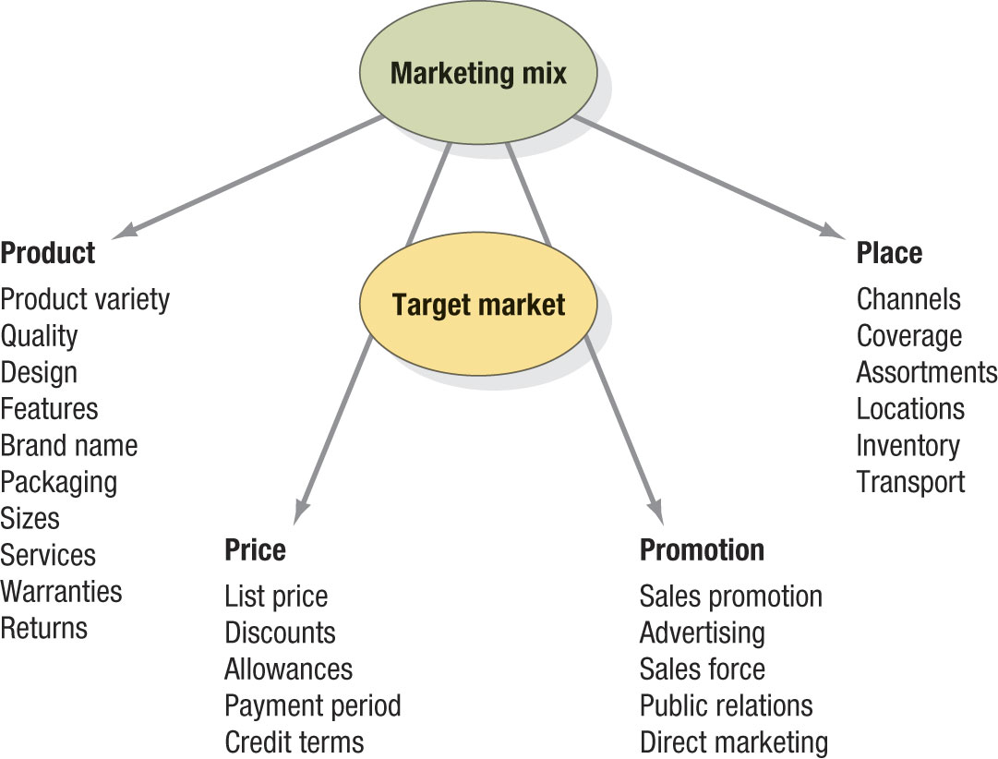
Marketing Concept - The 4 P’s

Slide 35
Marketing Concept - The 4 P’s ğ The 4 Cs
Marketing
Mix
Product
Place
Price
Promotion
Convenience
Customer
Solution
Customer
Cost
Communication

Slide 36
Marketing Concept (cont.)
Integrated Marketing (cont.)
  Marketing must be well coordinated with other departments in the company;
  all departments have to work together to satisfy customers’ needs and wants
Profitability through customer satisfaction
  To achieve profits as a result of creating superior customer value

Slide 37
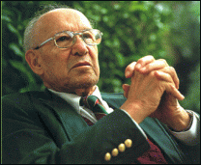
Selling – Marketing...
“There will always be need for
some selling. But the aim of marketing is to make selling superfluous. The aim of marketing is to know and understand the customer so well that the product or service fits him and sells itself. Ideally, marketing should result in a customer who is ready to buy.”
Peter Drucker

Slide 38
Modern Marketing Concept Traditional Organization Chart
Top
Management
Middle Management
Front-line people
Customers

Slide 39
Modern Marketing Concept Customer-Oriented Organization Chart
Customers
Front-line people
Middle management
Customers
Customers
Top
manage-
ment

Slide 40
Relationship Marketing Concept
Customer Relationship Management ğ the overall process of building and maintaining profitable customer relationships by delivering superior customer value and satisfaction.
  It deals with all aspects of acquiring, keeping and growing customers
  Relationship building blocks ğ “customer value” and “customer satisfaction”
  “Customer retention” and “customer loyalty”
  The intention ğ to gain a greater proportion of an existing customer’s purchases over a long period (increase “consumer lifetime value”!)

Slide 41
Relationship Marketing Concept
“Our slogan ‘5+Million More Smiling Customers’ is not about reaching sales targets but about whether we are able to provide greater satisfaction to a greater number of customers...
The goal is to improve customer satisfaction which translates to an increased number of ‘smiling customers’.”
  Tokuichi Uranishi
  Executive Vice President,
  Toyota Motor Corporation

Slide 42
Connections With Customers –
Not All Customers are Equal
Most marketers are targeting fewer, potentially more profitable customers.
Asking:
  What value does the customer bring to the organization?
  Are they worth pursuing? – customer profitability analysis
Focus has shifted to:
  keeping current customers, and
  building lasting relationships based on superior satisfaction and value.
    It costs 5 to 10 times as much to attract a new customer as it does to keep a current customer satisfied.

Slide 43
Customer Relationship Management Capturing Value from Customers
Key Concepts
Customer delight leads to emotional relationships and loyalty
Customer Lifetime Value (CLV) shows true worth of a customer
Customer Loyalty and Retention
Share of Customer
Customer Equity

Slide 44
Customer Relationship Management Capturing Value from Customers
Key Concepts
Share of customer’s purchase in a product category.
Achieved through offering greater variety, cross-sell and up-sell strategies.
Customer Loyalty and Retention
Share of Customer
Customer Equity

Slide 45
Customer Relationship Management Capturing Value from Customers
Key Concepts
The combined customer lifetime values of all current and potential customers.
Measures a firm’s performance, but in a manner that looks to the future.
Choosing the “best” customers is key
Customer Loyalty and Retention
Share of Customer
Customer Equity

Slide 46
Societal Marketing Concept
Company’s negative effects on society
Conflict between consumer wants and long-term social welfare
Marketing managers should be concerned with social responsibility
The societal marketing concept
  Company’s task is to determine needs and wants of target markets & to satisfy them more effectively and efficiently than competitors --in a way that preserves or enhances the consumer’s and society’s well-being.

Slide 47
Societal Marketing Concept
Society
(Human Welfare)
Societal
Marketing
Concept
Consumers
(Want Satisfaction)
Company
(Profits)

Slide 48
Marketing Landscape
Challenges
Growth of the Internet
Advances in telecommunications, information, transportation
  Customer research and tracking
  Product development
  Distribution
  New advertising tools
  24/7 marketing through the Internet
Digital age
Globalization
Ethics and social responsibility
Not-for-profit marketing
Marketing relationships

Slide 49
Marketing Landscape
Challenges
Geographical and cultural distances have shrunk
  Greater market coverage
  More options for purchasing and manufacturing
  Increased competition from foreign competitors
Digital age
Globalization
Ethics and social responsibility
Not-for-profit marketing
Marketing relationships

Slide 50
Marketing Landscape
Challenges
Marketers need to take great responsibility for the impact of their actions
Digital age
Globalization
Ethics and social responsibility
Not-for-profit marketing
Marketing relationships

Slide 51
Marketing Landscape
Challenges
Many organizations are realizing the importance of strategic marketing
  Performing arts
  Government agencies
  Colleges, universities
  Hospitals
Digital age
Globalization
Ethics and social responsibility
Not-for-profit marketing
Marketing relationships

Slide 52
Marketing Landscape
Challenges
Profits through managing long-term customer equity
  Improve customer knowledge
  Target profitable customers
  Keep profitable customers
Digital age
Globalization
Ethics and social responsibility
Not-for-profit marketing
Marketing relationships

